Slide 1
Community Based Irrigation Project
31 st May 2023

Slide 2
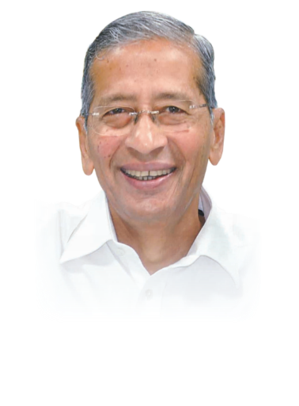
“Leave this world better than you found it.”
Bhavarlal H. Jain
Founder
1937-2016
One man's desire to improve the lot of his fellow men, spearheaded a revolution in sustainable agriculture that has transformed the lives of millions of farmers, associates, stake holders and the society around the world.
Every business of Jains, ensures that it creates shared value, nurtures the environment and contributes significantly to the water and food security of the world.
Small Ideas. Big Revolutions.®
www.jains.com

Slide 3
Features of R to R
Integration of following components is referred as R To R
Development of Water Source
Construction of necessary Civil works
Conveyance of water from source through closed piping up to farm gate
On farm Irrigation through Micro Irrigation
Pumping Machinery & Power (Electrical / Solar) network
Automation System to monitor & operate the scheme
Maintenance of the project
Training & capacity building of beneficiaries through WUAs
Development of Market Linkages

Slide 4
Few options of R To R

Slide 5
Few options of Jain Integrated Irrigation Solutions (JIIS)

Slide 6
R To R – Challenges and Solutions
Challenge | Solutions
In canal commands water is available at intervals ranging between 10 to 30 days· whereas in micro irrigation frequent watering is required. | Supply of water through canals at more regular intervals, preferably on continuous basis.
 | On farm storage facilities on individual farms have to be created·.
 | Community storage facilities for groups of farmers·, village tanks and water harvesting facilities to be used as storages·.
 | Conjunctive use of groundwater i.e. whenever canal water is not available farmers have to use their water wells.
 | Piped distribution network and use of micro irrigation system which allows irrigation at frequent intervals.
Cultivation of low income crop like cereal etc.. | Alternative high income crops need to be recommended and promoted.
 | Crop sequence and rotation need to be evolved so as to improve income from agriculture.
 | Subsidy support to farmers for adoption of piped distribution networks.
No or low reliability of water supply, leading to cultivation of low income crops. | As water availability from canals is not reliable, farmers resort to low risk crops with which their financial loss would be minimum. Assured availability of water will enable them to take up high income crops
 | Conjunctive use of groundwater due to which farmers can opt for high income crops.

Slide 7
R To R – Challenges and Solutions
Excessive sedimentation and debris in canal waters | On farm storages, community storages, etc., in order to allow for settlements of sediments and debris in canal water.
 | Use of suitable filtration systems with automatic backwash arrangements
Mismatch of water requirement among farmers at a given point of time . | Specific/mono cropping patterns with limited choice for group of farmers should be promoted
 | Predefined uniform cropping patterns and uniform planting times at least for small groups of farmers will have to be followed
Variations in crops being grown from season to season and year to year | Introduction of perennial crops, wherein cropping patterns can be stable for long periods.
Variation in the use of irrigation systems leading to increase or decrease in system pressures, which damages the system components. Such a variation in use of the system will also result in wastage of pumping energy | Protection equipments such as Pressure Relief Valves need to be included.
 | Pumping units shall contain Variable Frequency Drives(VFDs) in order to vary the energy requirements based on system demand.

Slide 8
R To R – Challenges and Solutions
Non-cooperation among farmers on an outlet or a minor | Automation ensures precise timely delivery of water to the plants without physical presence of the farmers in the field .
Reluctance of implementing authorities for acceptance of technology due to unawareness | Awareness meetings to bring the change in mindset of implementing authorities.
Non availability of funds with the farmers to bear the system costs | Subsidy assistance to be extended.
 | Easy loan and credit facilities to be made available.

Slide 9
R To R – A Path breaking Solution
Investigation and Survey
Engineering Design
Material Supply
Execution
Operation and Maintenance
Training and Capacity Building
Handing Over
Extension and R & D support
Monitoring and Evaluation

Slide 10
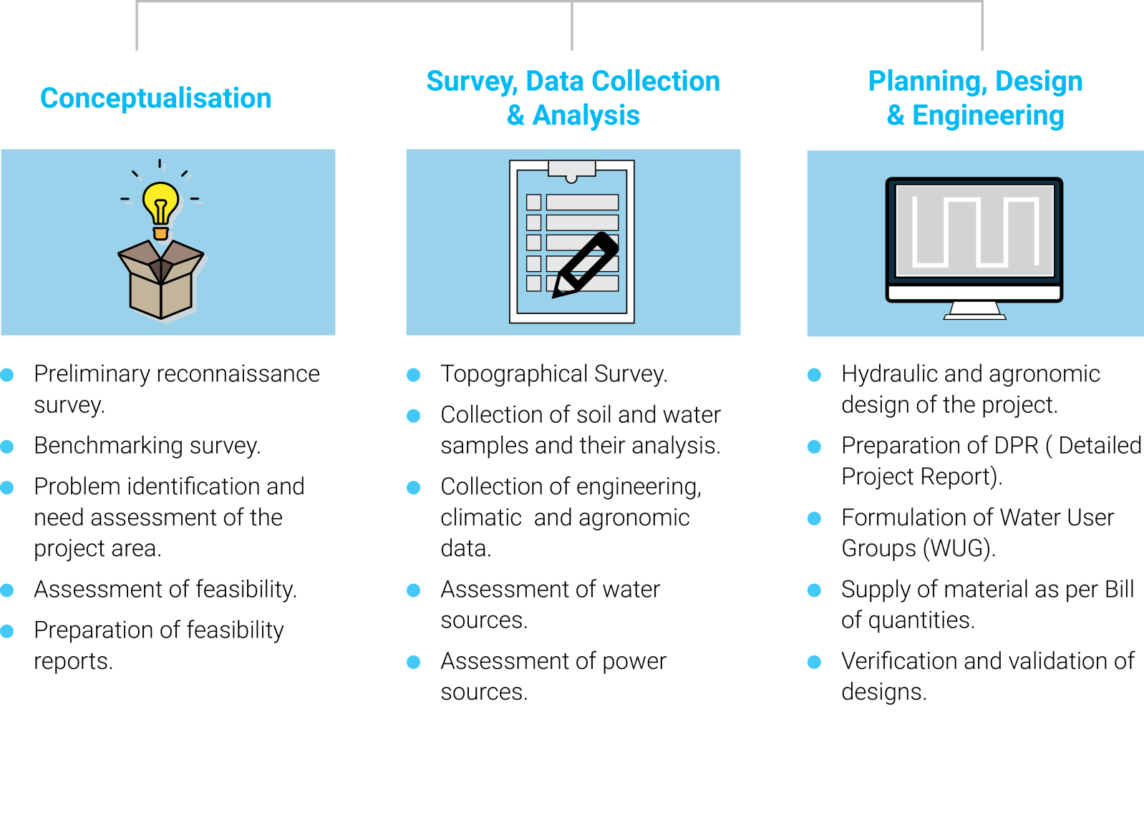
R To R - Methodology

Slide 11
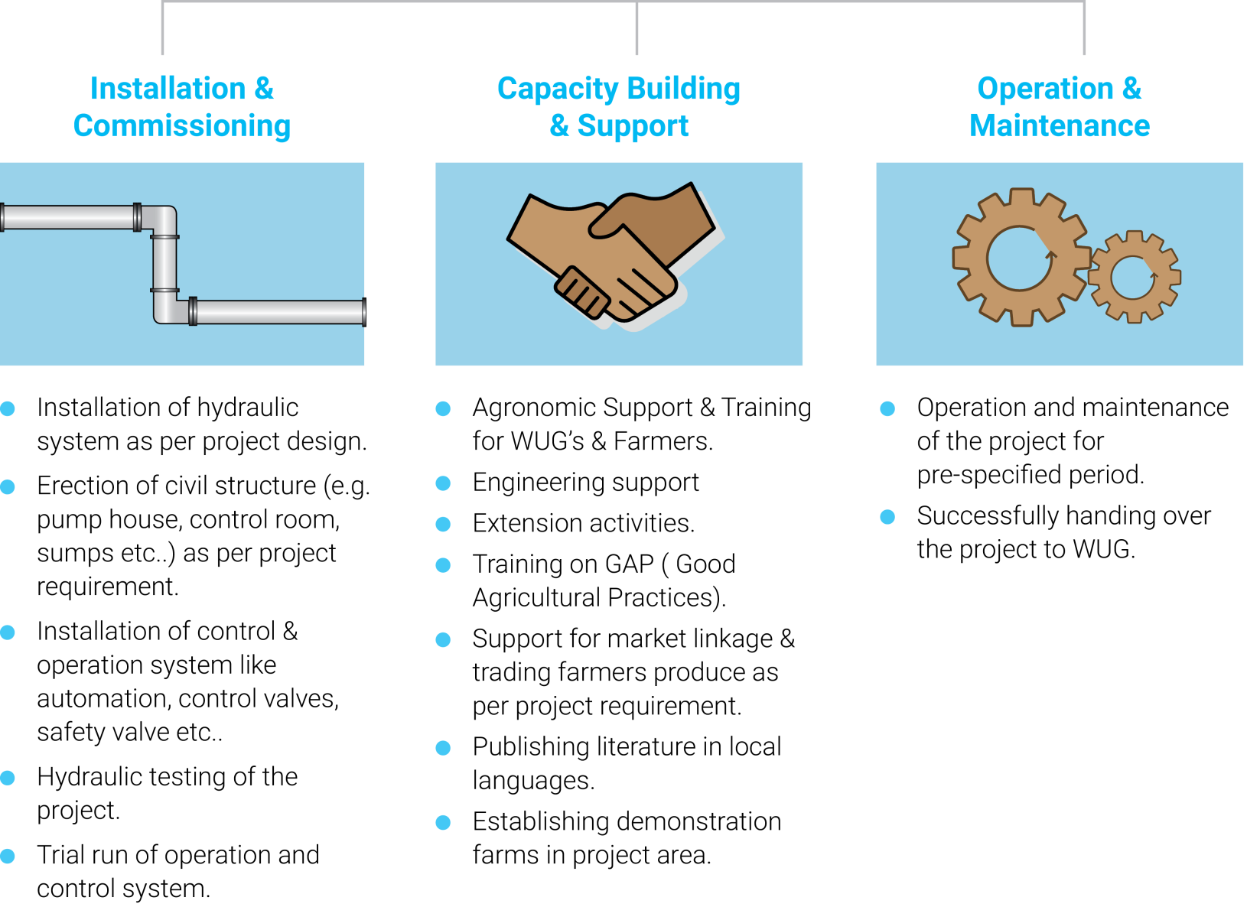
R To R - Methodology

Slide 12
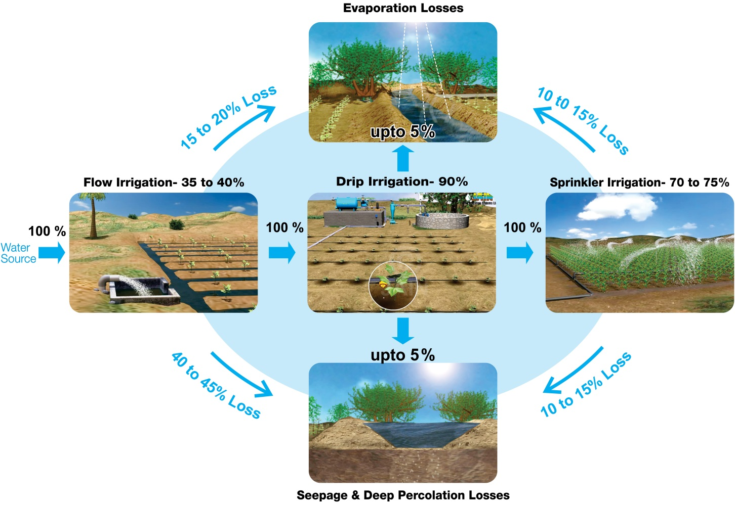
Water Losses in Different Irrigation methods

Slide 13
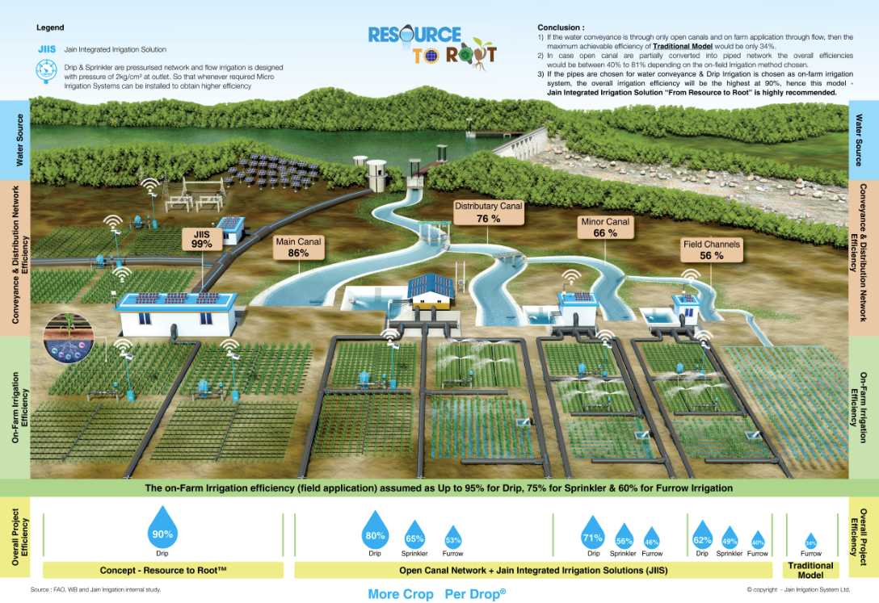
Technology for Efficiency Improvement

Slide 14
Concept - Resource to Root™ -
Ensures Higher Water Productivity & Efficiency
Irrigation Efficiency
- Storage efficiency,
- Conveyance efficiency and
- Field application efficiency.
Overall project efficiency is a multiplication of all these efficiencies.
For calculation purposes following overall project efficiencies may be adopted

Slide 15
Concept - Resource to Root™ -
Ensures Higher Water Productivity & Efficiency
Crop/Land Productivity
Water Productivity
Energy Productivity
Value Creation
Life Cycle Analysis

Slide 16
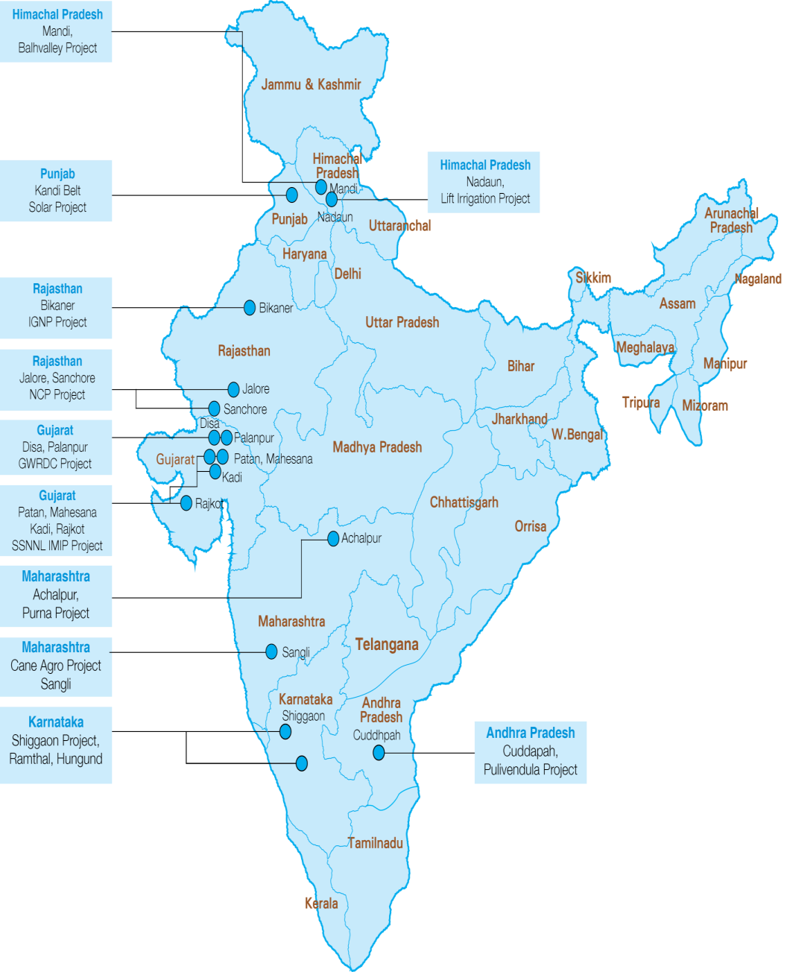
R to R-India Scenario

Slide 17
References
FAO Manual
Guidelines for improving Water Use Efficiency in Irrigation, Domestic and Industrial sector, by CWC, New Delhi
Ministry of Water Resources, Government of India
Narayanmurthy’s research papers
Das, Anup., Mudra, G, C., Patel, D, P., 2009. Technological Options for Improving Nutrient and Water Use Efficiency
Strategies to Improve Water Use Efficiency, 2016. http://extension.psu.edu/plants/crops/news/2016/07/strategies-to-improve-water-use-efficiency , accessed on 5th Oct, 2016
17

Slide 18
Ramthal Project ( East Side) General Conceptualized in 2014, it is one of the world’s largest fully automated lift and drip systems;
DBOT with hybrid annuity model
Project Scope: Lift + drip system construction & O&M; farmer training
Project Size: Rs 384 Cr
Area: 12300 hectares
Private Sector Participation: With Jain and Agribusiness offtake
Payment Structure – DBOT with hybrid annuity:
Payment Terms : 70% upon completion of civil works; 30% over 5-year period

Slide 19
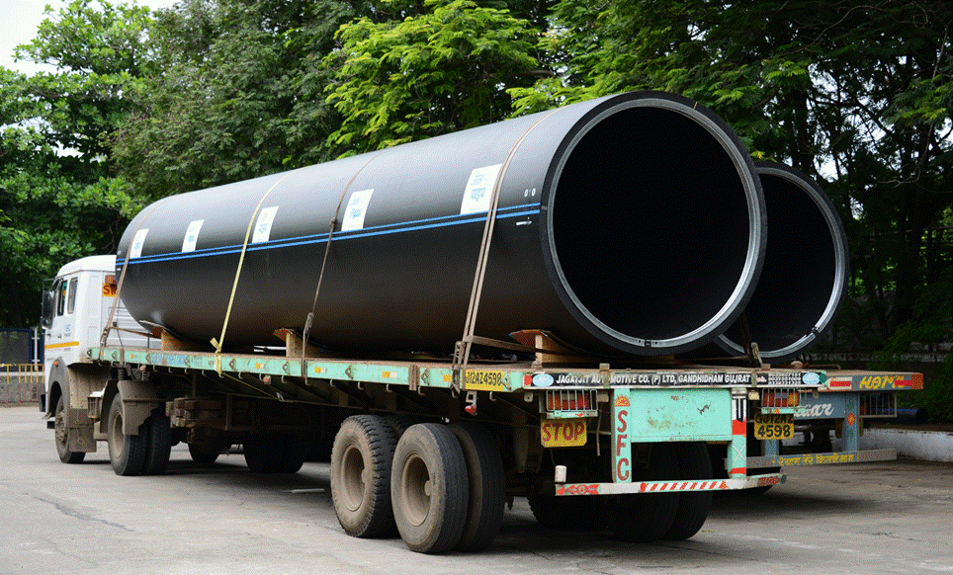
Thank You

Slide 20
Details of Projects Executed
Location | MRP Tirunelveli (T.N.) | AMRP Nalgonda ( A.P.) | SSNNL / GWRDC Different Districts (Gujarat ) |  | LIMIP Pulivendula (A.P.) | Purna C.Bhaga (MS) | Balh Valley Sundernagar (HP) | KNNL Shiggaon (KS) | IGNP Bikaner (Raj.)
Area to be / Irrigated (Ac) | 988 | 533 | 617 | 455 | 14,820 | 29600 | 5,817 | 24,453 | 37,050
Beneficiaries | 600 | 180 | 200 | 216 | 5,000 | 10544 | 7,500 | 8,154 | 3,000
Water Source | M.I. Tank | Canal (AMRP) | Canal (SSNNL) | Community Tubewells | Canal (PBC) | Canal (Purna) | Canal (BBMB) | River (Varada) | Canal (IGNP)
Duration (Mnth) | 6 | 12 | 9 | 6 | 4 | 26 | 36 | 26 | 12
Handed Over | 2008 | 2009 | 2010 | 2011 | 2011 | 2011 | 2012 | 2012 | 2012
Maintenance Contract (Yrs.) | 1 | 2 | 1 | 1 | 3 | 2 | 5 | 2 | 2
System Type | Pressurised Drip / Sprinkler |  | Pressurised Drip |  | Pres. Drip / Sprinkler | Gravity Pipe | Pres. & Gvty. Sprinkler | Pressurised Drip / Sprinkler

Slide 21
Details of Projects Executed
Location | NCP Sanchore, (Raj.) | Ramthal Hungund (Kar.) | Cane Agro Sangli (MS) | Kandi Integrated Kandi (Punjab) | Nadaun Hamirpur (HP)
Area to be / Irrigated (Ac) | 3,38,400 | 30,381 | 2,009 | 1,642 | 7,360
Beneficiaries | 40,000 | 7,382 | 1,255 | 1,200 | 3,000
Water Source | Canal (Narmada) | Canal | Tank | Canal | Beas River
Duration (Mnth) | 21 | 24 | 12 | 12 | 24
Handed Over | In Progress | In Progress | In Progress | In Progress | In Progress
Maintenance Contract (Yrs.) | 3 | 2 | 1 | 7 | 5
System Type | Pressurised Drip / Sprinkler | Pressurised Drip | Pressurised Drip | Solar Powered Drip | Pressurised Sprinkler

Slide 22
Lift cum Drip Projects executed by Jain Irrigation in Maharashtra
Sr. No. | Sahkari Pani Puravtha Scheme Name | Place | Old/ New Scheme | Area Under Drip (Acre ) | No. of Farmers in Scheme | Lateral Spacing (ft) | Automation Type | Year of Installation | Status of Work
1 | Sampatrao Deshmukh Sahkari Pani Purvatha Santha, Raigaon | At-Raigaon, Tal-Kadegaon , Dist- Sangli | New | 2009 | 1545 | 6' & 8' | Auto. With Web Base | 2012-13 | Completed
2 | Devwadi SPPS, Devwadi | At- Devwadi, Tal-Shirala, Dist- Sangli | New | 30 | 40 | 4.5' | Auto,with wire | 2012-13 | Completed
3 | Bhairvanth Sahkari Pani Puravtha Sanstha Unit-1, Ahirwadi | At- Ahirwadi, Tal-Walva, Dist- Sangli | Old | 140 | 67 | 7' | Auto. With Wire | 2012-13 | Completed
4 | Bhairvanth SPPS Unit-2, Ahirwadi | At- Ahirwadi, Tal-Walva, Dist- Sangli | New | 100 | 74 | 7' | Auto. With Wire | 2013-14 | Completed
5 | Shivajirao Kadam SPPS, Ahirwadi | At- Ahirwadi, Tal-Walva, Dist- Sangli | New | 100 | 52 | 7' | Auto. Wireless | 2013-14 | Completed
6 | Satyeshwar SPPS, Kundal | At- Kundal, Tal -Palus Dist- Sangli | Old | 100 | 85 | 4.5 | Auto. With Web Base | 2013-14 | Completed
7 | Shri. Siddheshwar SPPS, Kavlapur | At- Kawlapur, Tal -Miraj Dist- Sangli | New | 240 | 110 | 4.5 | Auto. With Web Base | 2013-14 | Completed
8 | Late. Shiva Rama SPPS, Karbharwadi | At- Karbharwadi , Tal-Karvir, Dist- Kolhapur | Old | 100 | 133 | 4.5 | Auto. With Wire | 2014-15 | Completed
9 | Krantishingh Nana patil SPPS Brungwadi | At- Burungwadi, Tal-Walva, Dist- Sangli | Old | 40 | 28 | 5' | Auto. With Web Base | 2015-16 | Completed
10 | Pandurang Jadhav & others PPS , Dawaltwadi | At- Dawaltwadi, Tal-Kagal, Dist - Kolhapur | New | 60 | 50 | 4.5' | Auto. Wireless | 2015-16 | Completed

Slide 23
Lift cum Drip Projects executed by Jain Irrigation in Maharashtra
Sr. No. | Sahkari Pani Puravtha Scheme Name | Place | Old/ New Scheme | Area Under Drip (Acre ) | No. of Farmers in Scheme | Lateral Spacing (ft) | Automation Type | Year of Installation | Status of Work
11 | Shri.Anantrao Dafale PPS Savarde Bk. | At- Savarde Bk , Tal-Kagal Dist- Kolhapur | New | 75 | 140 | 4.5' | Auto. With Web Base | 2016-17 | Completed
12 | Kameri -Yedenipani SPPS Kameri | At- Kameri, Tal-Walva, Dist- Sangli | Old | 160 | 118 | 4.5' | Auto. With Web Base | 2016-17 | Work Going on
13 | Shri. Ch. Shahu SPPS Sangaon | At- KasbaSangaon , Tal-Kagal ,Dist- Kolhapur | Old | 60 | 50 | 4.5' | Auto. Wireless | 2016-17 | Completed
14 | Rayat sikshan Santha -Rukadi | Rukadi, Tal-Hatkanagale, Dist- KOLHAPUR | NEW | 100 | 1 | 4.5' | Auto. Wireless | 2016-17 | Completed
15 | Javahar SPPS ,Talandge | At- Talandge, Tal- Hatkangale, Dist-Kolhapur | Old | 412 | 385 | 4.5' | Auto. With Web Base | 2017-18 | Work Going on
16 | Shri. Siddheshwar SPPS, Shendur | At- Shendur, Tal- Kagal, Dist-Kolhapur | Old | 100 | 125 | 4.5 | Auto. With Web Base | 2017-18 | Work Going on
17 | New Arunoday SPPS ,Alsand | At- Alsand, Tal- Palus, Dist-Sangli | Old | 160 | 82 | 4.5 | Auto. With Web Base | 2017-18 | Work Going on
18 | Adinath SPPS Vasagade, | At- Vasagade, Tal- Palus, Dist-Sangli | NEW | 43 | 22 | 5' | Auto. Wireless | 2017-18 | Work Going on
19 | Dr.Patangrao Kadam Yashwant SPPS Palus | At- Palus, Tal- Palus, Dist-Sangli | Old | 1600 | 670 | 4.5' | Auto. With Web Base | 2017-18 | Work order received
20 | Bisur Dhadak Lift Iriigation Scheme,Bisur | At- Bisur, Tal- Miraj, Dist-Sangli | Old | 1200 | 456 | 4.5' | Auto. Wireless | 2018-19 | Work order received

Slide 24
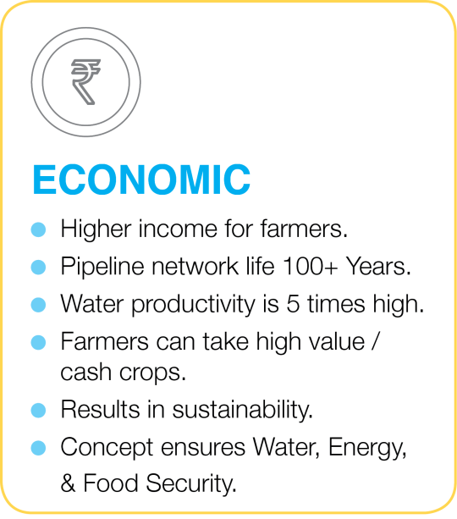
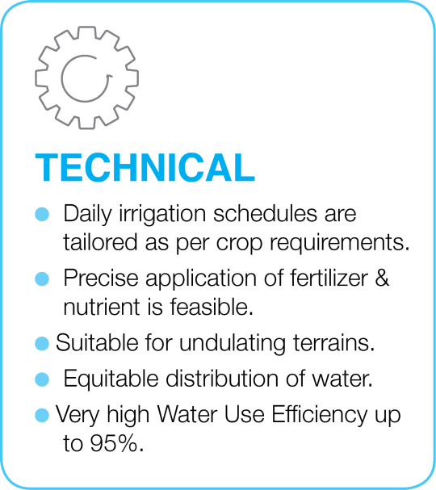
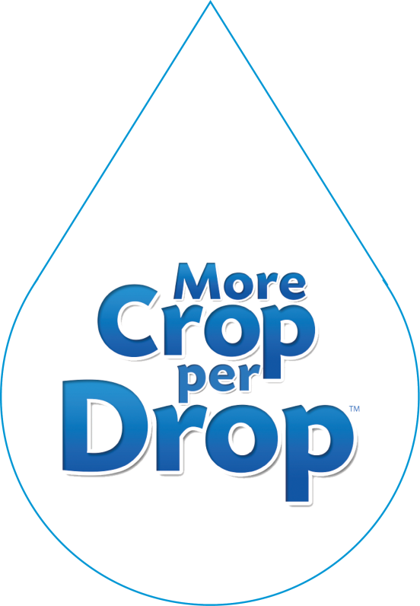
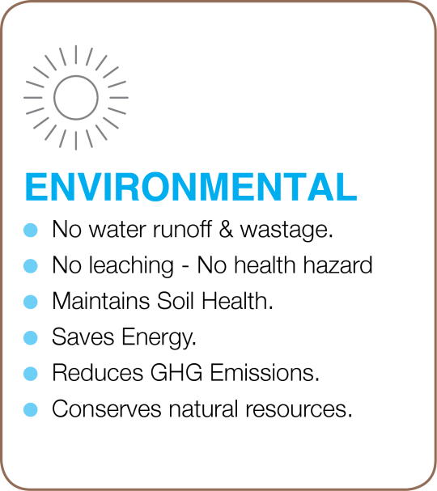
Benefits of Resource to Root™

Slide 25
Way Forward ….
The objectives and performance parameters should be made clear at project planning stage itself. To bring sustainability to the project following parameters should be considered at the time of biding.
a) Irrigation Efficiency b) Crop Productivity
c) Water Use Efficiency d) Energy Productivity
e) Value Creation
Irrigation project should not be merely seen as water distribution system or creation of water distribution network. It should be planned as integrated agricultural irrigation project having last mile connectivity. In short approach should be “From Resource to Root”
Considering the unmatched sustainable benefits, ONLY Integrated Micro Irrigation Projects ( i.e Model 1 in the picture with Drip Irrigation having 90% Overall efficiency) should be undertaken.
Adoption of On – farm drip/sprinkler irrigation is a MUST and should be integral part of the project. Flood irrigation should never be allowed.

